Slide 1







NCV Management
System
(NMS)
Presented by: Ms. Ma. Monica Saludo
BUSINESS ADMIN. – PC SECTION / SALES GROUP
Notes:
A pleasant good afternoon to everyone!
I am Ma. Monica Saludo from PC-SALES GROUP.
To present to you our KAIZEN entitled NCV MANAGEMENT SYSTEM or N.M.S.

Slide 2








What is NCV ?
(No Commercial Value)
Used as pro forma for commercial invoice to indicate that the goods to be shipped, usually requested by FTEC but not as Sales therefore as NCV.
Notes:
First, let me define, what is NCV ?
NCV or No Commercial Value
is used as pro forma for commercial invoice
to indicate that the goods to be shipped usually requested by FTEC
but not as Sales therefore as NCV.

Slide 3
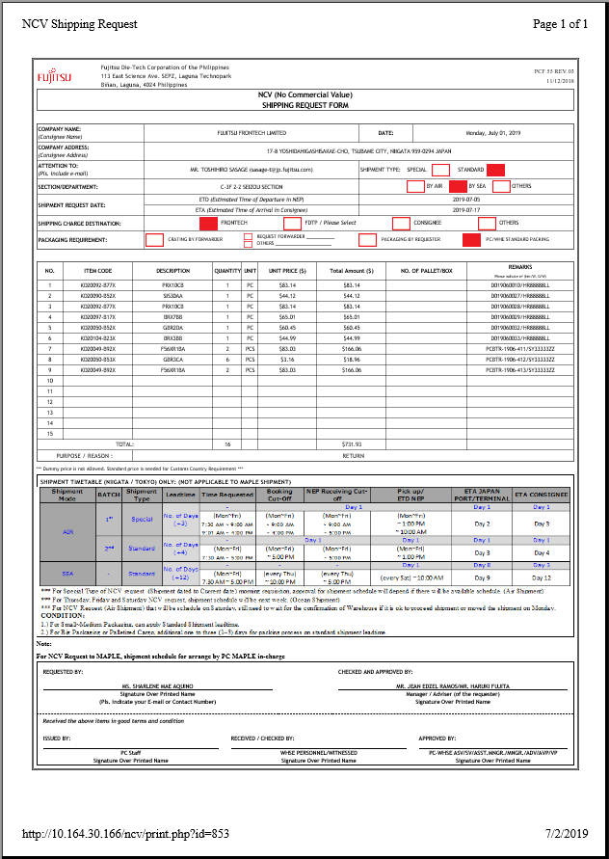
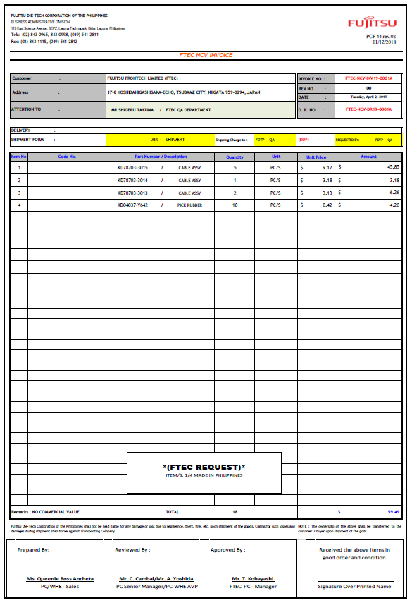
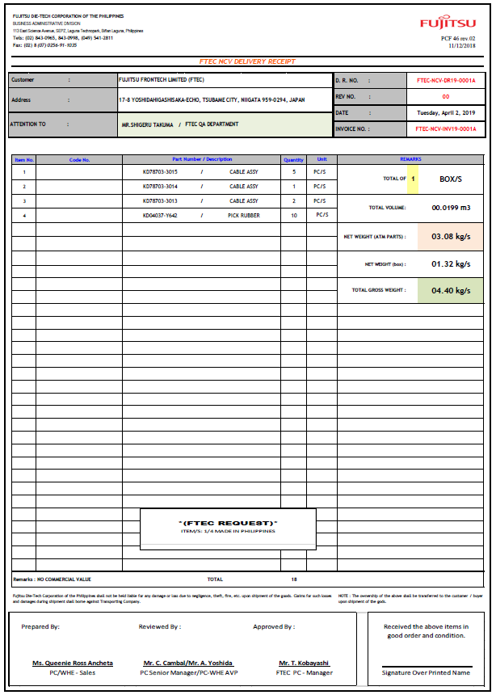







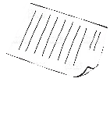
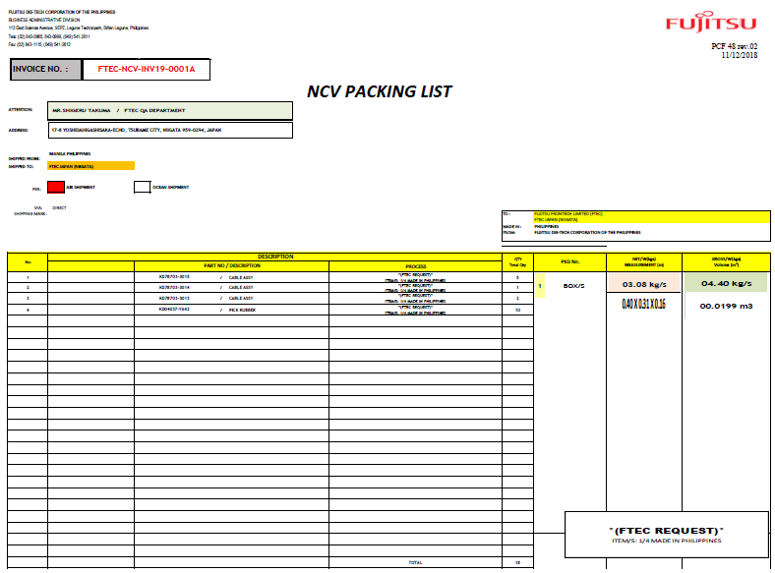











OUR CURRENT PROCESS
15mins.
Check & Review NCV Details
Approving Manual Request
10 mins.
Making Shipment
Documents
10 mins.
1 Pallet
L = 110 cm
W = 110 cm
H = 90 cm
Weight = 75 kg.
PC/WHE MANAGER
PC NCV IN-CHARGE
15 mins.
Checking & Signing of NCV Request
Receiving and Packing
NCV Requisition thru system
20
mins.
SmAquino
JeRamos
SmAquino
JeRamos
7/5/19
W.Ilao/S.Aquino
Monica Saludo 7/5/19
Monica Saludo 7/5/19
REQUESTOR
SECTION
SUPERIOR
WHE IN-CHARGE
Notes:
Let me show to you our current process:
1.The requestor will input NCV shipment thru system and will print out 3 copies of NCV request.
( 1 for requestor, 1 for PC and 1 for Warehouse )
2. The 3 copies will be forwarded to section superior for checking and signatory.
3. Then, requestor will forward the NCV requisition form to PC in-charge for review of details and signatory.
< PAUSE >
4. Upon PC’s request of PEZA to WHE in-charge
5. The requestor will deliver the actual together with the signed NCV docs to WHE for Packing.
6. Once finished, WHE staff will forward NCV docs including the declared packing and weight to PC-in charge
7. PC in-charge will make and print (2) two copies each for Invoice/DR/ and NCV Packing list for booking request in NEP.
8. PC in-charge will forward FTEC NCV Doc to PCWHE-Superior for signatory.
9. After signed by the PCWHE-Superior, documents will forward to WHE

Slide 4



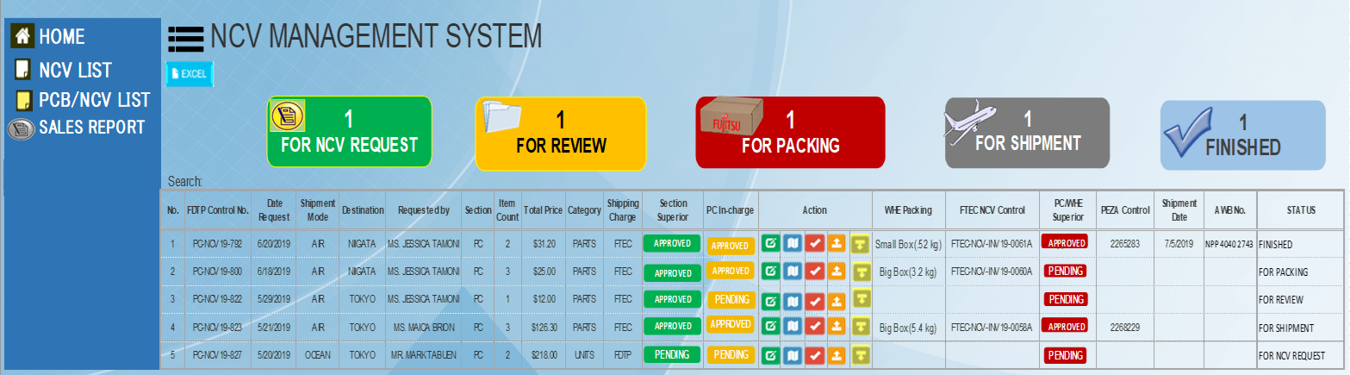

PROPOSAL
Downloading of PDF NCV documents generated by system
System checking and inputting
Approval of Final NCV Shipment
Acceptance of NCV Requisition on system
DOWNLOAD
SYSTEM
PREPARED
SYSTEM
PC/WHE MANAGER
30 mins.
(per request)
PC NCV IN-CHARGE
Checking and Approval of NCV Request
Receiving and Packing
NCV Requisition thru system
Packaging Details
And
Weight of the item
INPUT
SYSTEM
INPUT
SYSTEM
SYSTEM
REQUESTOR
SECTION
SUPERIOR
WHE IN-CHARGE

Slide 5
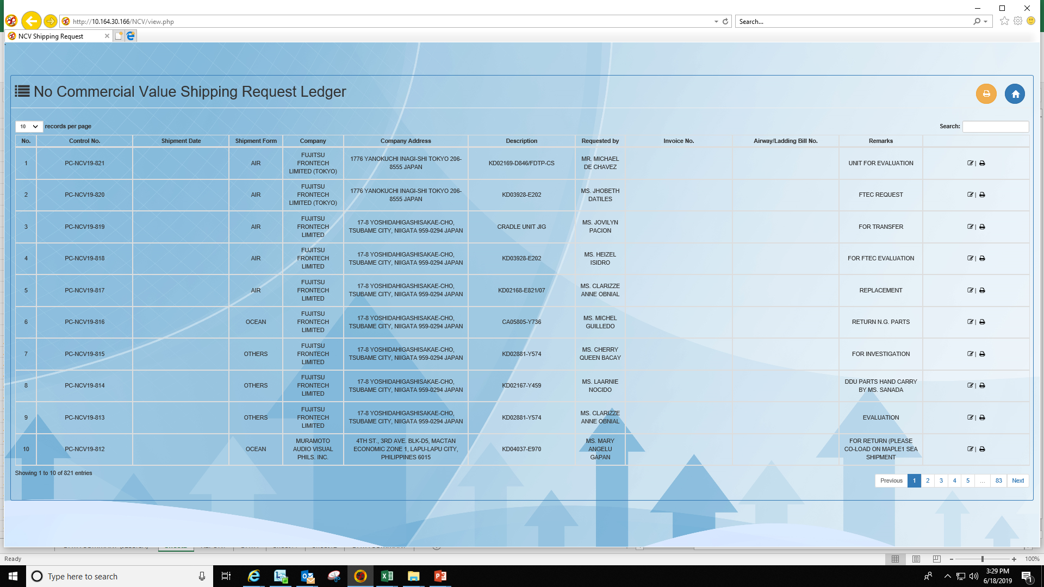


PROBLEMS ENCOUNTERED:
OBJECTIVES:
1
1
MUDA OF MOTION (Manual Work)
TO ELIMINATE MUDA OF MOTION (System Approval)
Check & Review NCV Details
Approving NCV Request
2
2
PAPER CONSUMPTION
TO REDUCE PAPER CONSUMPTION
Consumed: 1 hr.& 10 mins
3
SYSTEM
SYSTEM
3
LACK OF DETAILS IN CURRENT NCV SYSTEM
TO HAVE CENTRALIZED NCV SYSTEM MONITORING
CURRRENT PROCESS | NCV Count | PC IN-CHARGE
Average Monthly Req. | 40 request | 320 papers
Consume: 30 mins.
PC/WHE MANAGER
PC NCV IN-CHARGE
Total=440 papers
(1 Ream)
Checking & Signing of NCV Request
Receiving and Packing
NCV Requisition thru system
1
FOR NCV REQUEST
?
X
?
?
CURRRENT PROCESS | NCV Count | Requester
Average Monthly Req. | 40 request | 120 papers
SYSTEM
INPUT
Total: 160 papers
SYSTEM
REQUESTOR
SECTION
SUPERIOR
WHE IN-CHARGE
Notes:
With our current process, we encountered the following problems:
First, Muda of Motion or Manual Work
(And it consumed 1 hour and 10 minutes)
Second, Paper Consumption
In our current process, average monthly requisition is 40 requests,
Which consumes 320 sheets of paper for PC in-charge,
And 120 sheets of paper for requestor,
With a total consumption of 440 sheets of paper.
Lastly is the Lack of Details in Currrent NCV System
Like the shipment date, invoice number and shipping document details.
So we’ve come up to the following objectives:
First, To eliminate MUDA of Motion thru System Approval
That will only consume 30 minutes
Second, To reduce paper consumption
Which will only consume 160 sheets of paper for requestors
And last but not the least, To have centralized NCV System Monitoring

Slide 6









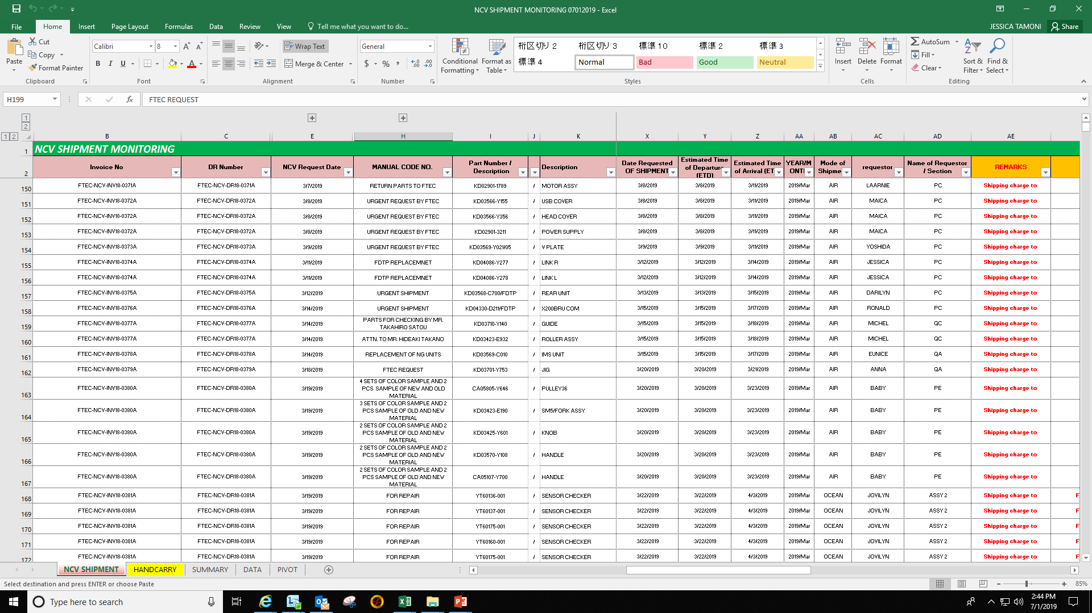
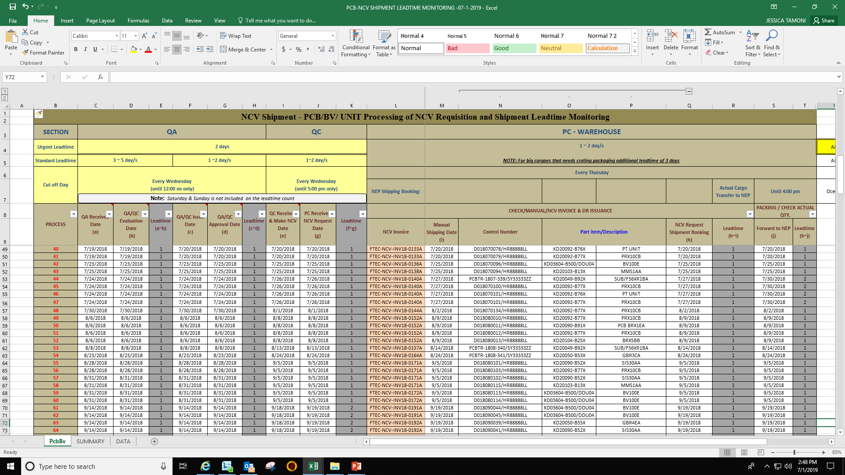
KAIZEN SUMMARY
OBJECTIVES | CURRENT | PROPOSAL | RESULT
SAVE 40
Mins.
1. To Eliminate MUDA of Motion
(Manual Work)
1 hr. &
10 mins.
(per request)
30 mins.
(per request)
SYSTEM
2. To Reduce Paper Consumption
440 papers
160
papers
“NMS”
Database
64%
3. To have a Centralized NCV System Monitoring
?
?
ACCESSIBLE & RELIABLE DATA
Notes:
For our Kaizen Summary,
First objective, To Eliminate MUDA of Motion (Manual Work)
With our current process, consumes 1hr & 10 minutes
And for our proposal, will consume only 30 minutes
RESULT: SAVE 40 MINUTES !!
Second objective, To Reduce Paper Consumption
With our current process, consumes 440 sheets of papers
And for our proposal, will consume only 160 papers
RESULT: Paperless , which decrease 64%
Third objective, To have a Centralized NCV System Monitoring
With our current process, lack of details and No Status Information
And for our proposal , complete NCV System
RESULT: ACCESSIBLE & RELIABLE DATA

Slide 7
















!
!
PC SECTION -- SALES GROUP
Presented by: Ms. Ma. Monica Saludo

